Slide 1
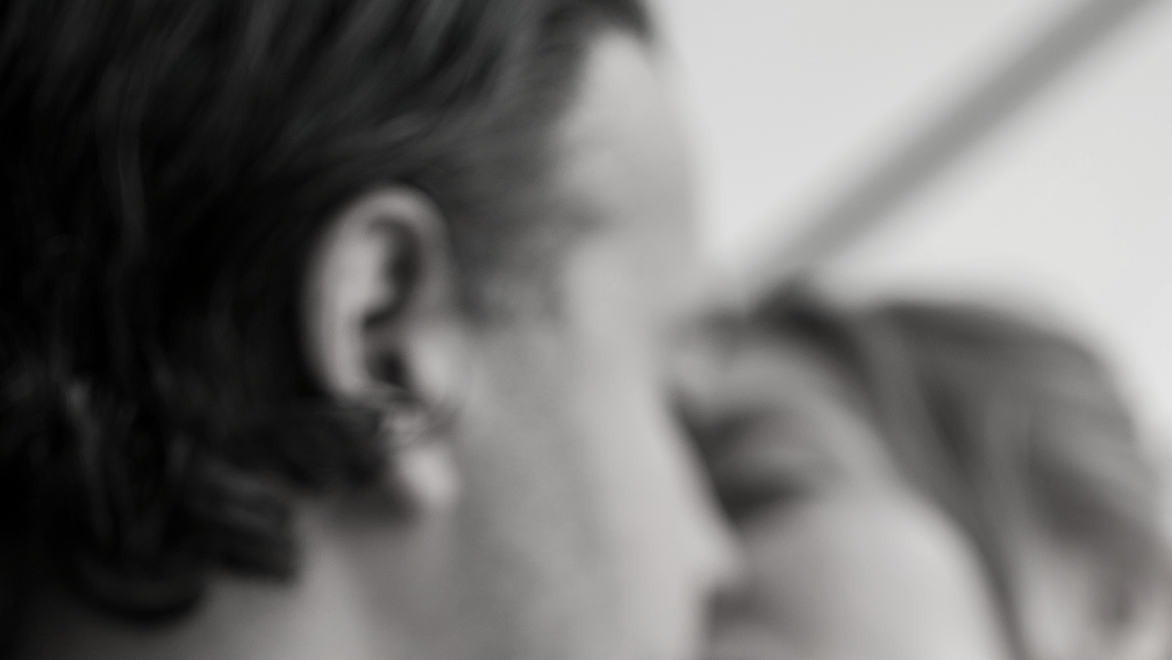
A great night out?

Slide 2
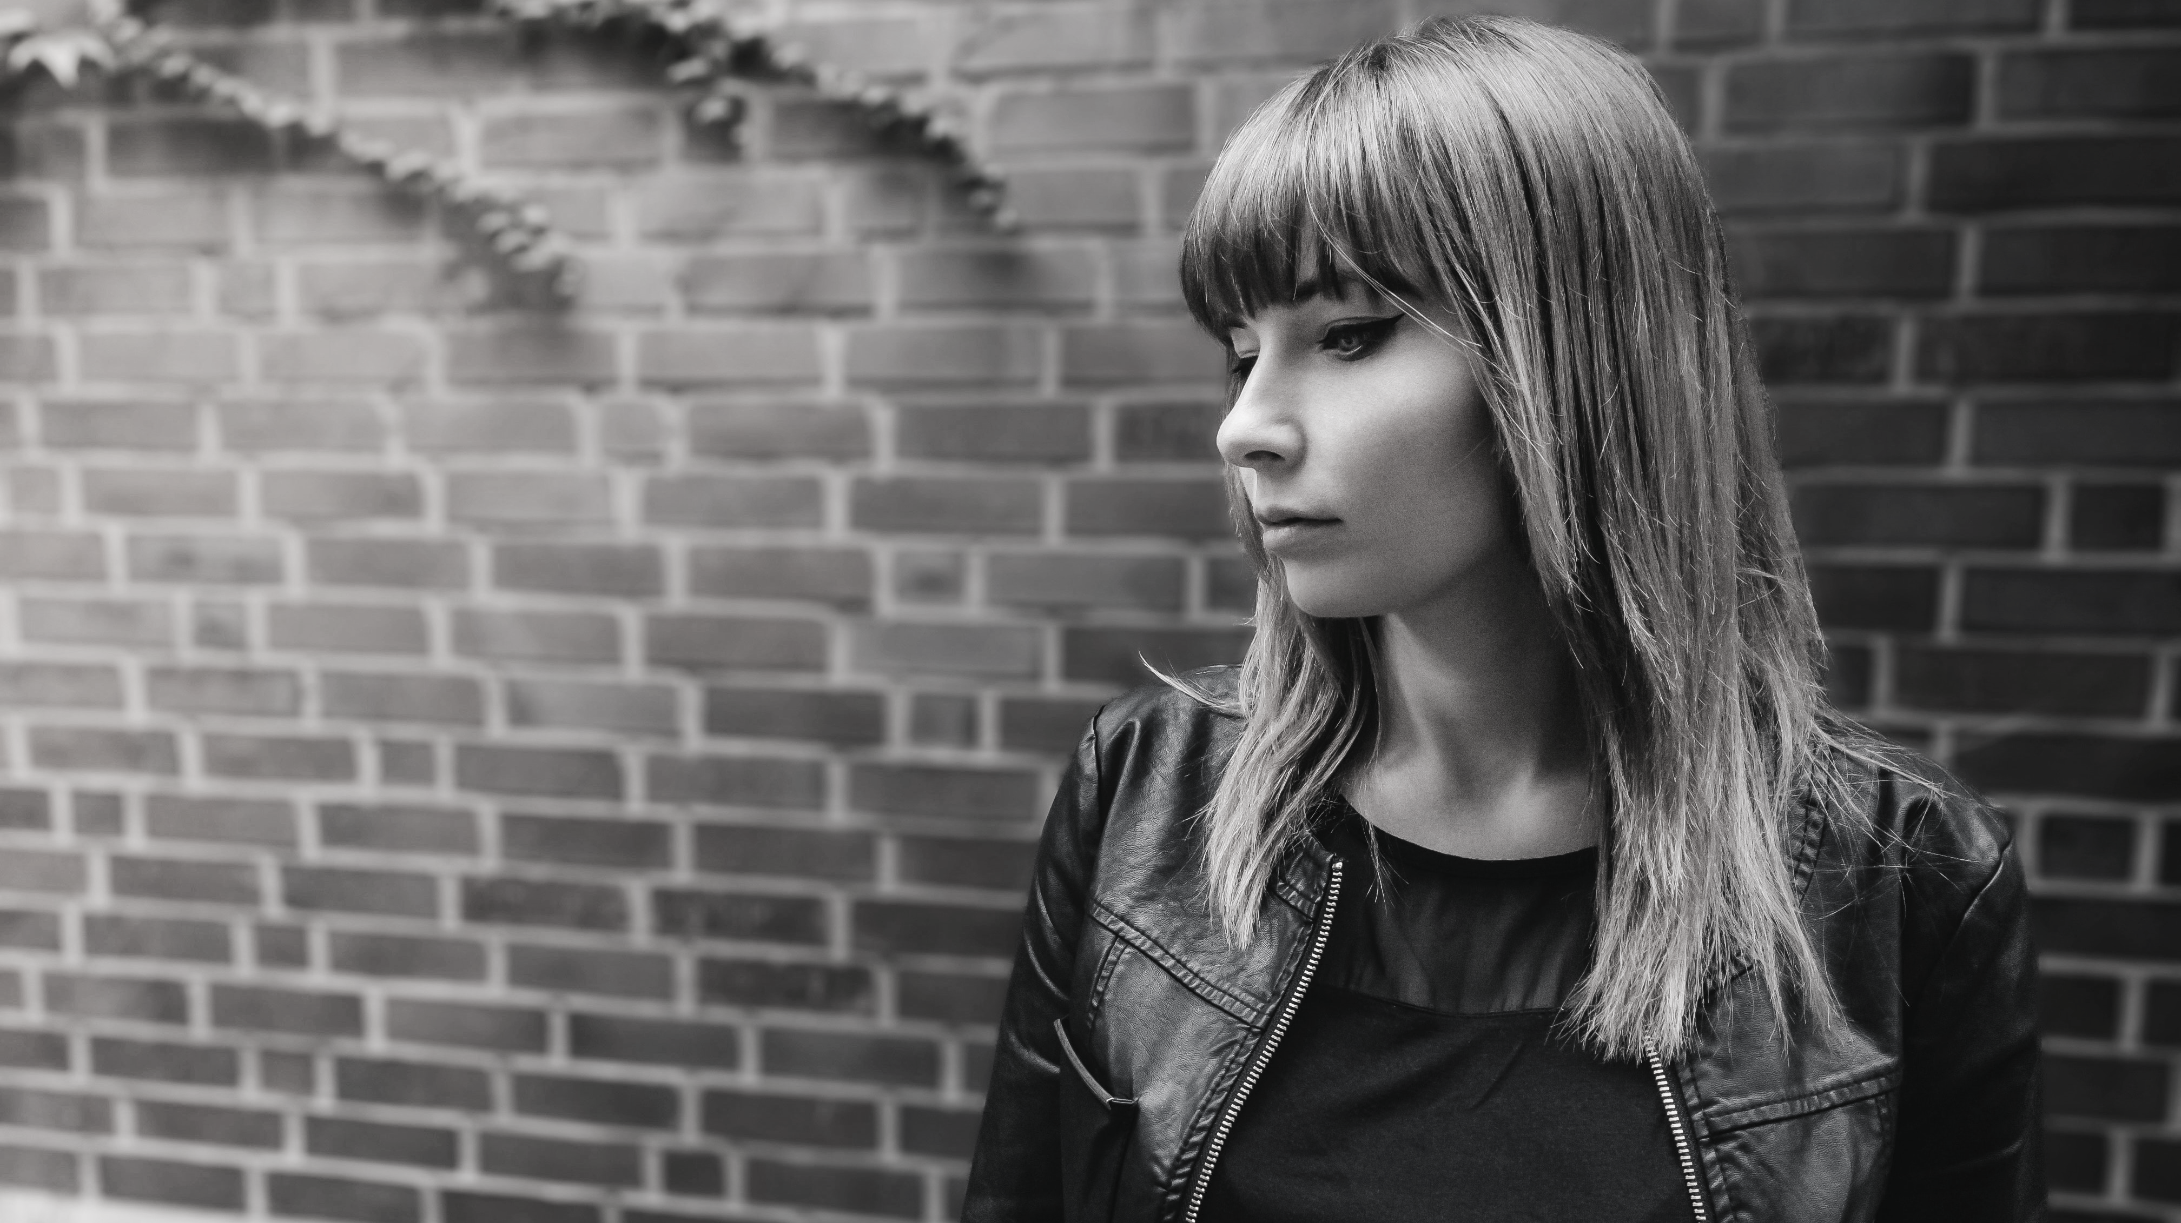
In this session…
Violence against women and girls
Alcohol and drink spiking
Personal safety
Peer support

Slide 3
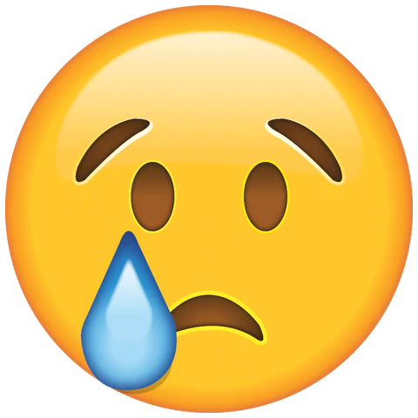
A great night out?
In just a few years, you will legally allowed to drink alcohol in public.
In groups, you will decide how safe you feel during each part of the scenario. Each of you will react differently and have different opinions on what feels safe.
Happy
Funny
Sad
Scared
Sick
Angry

Slide 4
OK, let’s start…

Slide 5
1
Pre-drinks
Friend’s house
Taken alcohol from parent’s cupboard without permission
4 of your best friends (all girls)
Notes:
What are the signs to look for

Slide 6
1
Pre-drinks
Happy
Funny
Sad
Scared
Sick
Angry
In your groups:
How comfortable do you feel?
How do you see this evening going?
Is there anything you need for your night out?
Notes:
What are the signs to look for

Slide 7
2
Beach
Joined by others who bring more alcohol
Argument with another group also drinking
A boy who is a friend of one of your friends notices you
2 of your friends are picked up by parents. You decide to stay
Notes:
What are the signs to look for

Slide 8
2
Beach
Happy
Funny
Sad
Scared
Sick
Angry
In your groups:
How safe is the environment you are in?
What impact is the alcohol having?
How comfortable do you feel not knowing everyone?
What role do boys have in everyone having a safe evening?
Notes:
What are the signs to look for

Slide 9
3
Pub
The group is getting bigger
Door staff check your age
You continue drinking
Only 1 of the starting group is still with you.
The boy from the beach offers to buy you a drink
Notes:
What are the signs to look for

Slide 10
3
Pub
Happy
Funny
Sad
Scared
Sick
Angry
In your groups:
Is the pub a safer environment?
Have you had enough and want to go home?
How do you feel now that most of your friends have left?
Do you accept the drink?
Notes:
What are the signs to look for

Slide 11
4
Club
The club is very busy
The boy from the beach keeps looking at you and smiling
There is a bit of fighting resolved by the security staff
You are still drinking and leaving your drink unattended
You have an argument with your friend and she walks off.
Notes:
What are the signs to look for

Slide 12
4
Club
Happy
Funny
Sad
Scared
Sick
Angry
In your groups:
How safe do you feel?
What risks are there in the club?
How do you feel that you all your friends have gone?
Notes:
What are the signs to look for

Slide 13
5
Closing time
There are no taxis. There are some boys in a group nearby
Your friend is nearby still upset
The boy from the beach is waiting across the road
Your home is just over a mile away. You could walk it
What will you do?
Notes:
What are the signs to look for

Slide 14
5
Closing time
Happy
Funny
Sad
Scared
Sick
Angry
In your groups:
Do you
Make up with your friend
Go talk to the boy and head back to his place
Walk home
Notes:
What are the signs to look for

Slide 15
5
Closing time
Friend
Making up with your friend may be difficult, but it puts you in a safer position.
You can get home together.
Boy
The boy has in the past been a suspect for drink spiking.
How do you know that you will be safe in the company of someone you don’t know?
Walk
Walking home alone is not a good option. You are drunk and unaware of what is going on around you in the same way as if you are sober.
The boy follows you…
Notes:
What are the signs to look for

Slide 16
A great night out?
How do you decide when a situation is safe
How much does alcohol affect your decision making?
What do you need for a night out?
How do you know if someone is going to cause you harm?
What role do boys have in making a night out safe?

Slide 17
Questions?

