Slide 1

Anti-social behaviour

Slide 2
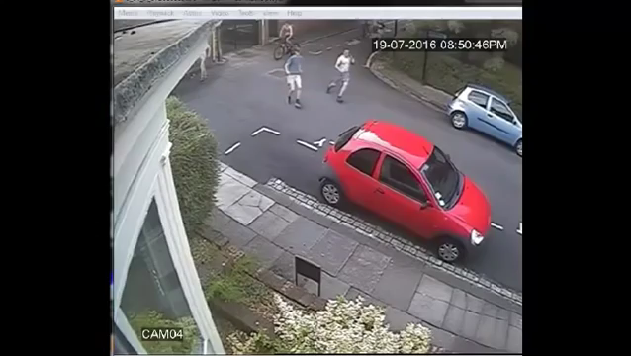

Slide 3
Can anyone tell me what is anti social behaviour?

Slide 4
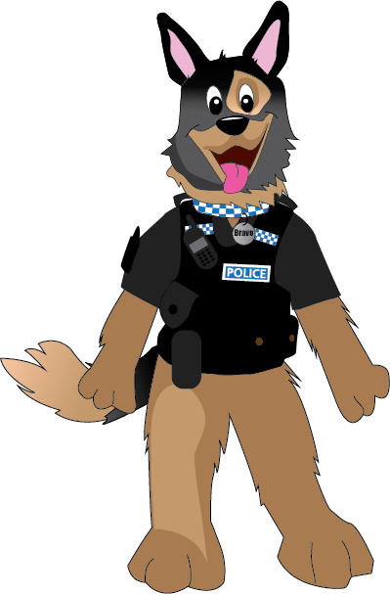
Anti social behaviour is…
Legal definition – The Crime and Disorder Act 1998 defines anti-social behaviour as acting in a manner that has "caused or was likely to cause harassment, alarm or distress to one or more persons not of the same household“
Antisocial Behaviour and Crime and Policing Act 2014 – “any behaviour that causes a detriment to the community and is persistent and unreasonable”

Slide 5
Personal
Nuisance
Environmental
Notes:
Personal - the behaviour is to be targeted at an individual or group e.g. damaging someone’s bike because you don’t like them.
Nuisance – It is causing trouble, being annoying or bringing suffering to the community e.g. playing loud music around .
Environmental - The incident is not aimed at an individual or group but targets the wider environment eg. graffiti

Slide 6
Can you think of any anti social behaviour?

Slide 7

Damage
Graffiti
Litter
Noise
Fireworks
Racism
Groups
Throwing
Alcohol
Begging

Slide 8
Can you match the words to the pictures?

Slide 9
What is in the bag?

Slide 10
Who are the victims of anti-social behaviour?

Slide 11
Elderly
Local shops
Children
Residents
School
Community
Different people
All of us

Slide 12
What sort of people do anti-social behaviour?

Slide 13
Young people
Drunks
Criminals
Drug users
Adults
Anyone
You?

Slide 14
What are the consequences to the victim?

Slide 15
Fear
Depression
Anger
Illness
Isolation
Money

Slide 16
What are the consequences for the offender?

Slide 17
5
10
Warnings
ABC contract
Harassment
Damage
Youth Offending team

Slide 18
How do we stop people doing it?

Slide 19
Education
Educating people so they know it is wrong.
Punishment
Scaring people so they won’t do it again.
Notes:
If a person is killed by someone throwing stones at a vehicle they may be charged with manslaughter, without intent.

Slide 20
Worksheet

Slide 21
What have we learned today?

