Slide 1
HATE CRIME
Notes:
You think you know what a Hate Crime is.
You think you can tell me an example of a Hate Crime.
You think you’ve witnessed a Hate Crime.

Slide 2
WHAT IS A
HATE CRIME?
Notes:
You think you know what a Hate Crime is.
You think you can tell me an example of a Hate Crime.
You think you’ve witnessed a Hate Crime.

Slide 3
PEOPLE WHO LOOK, SPEAK OR DRESS DIFFERENTLY ARE USUALLY THE VICTIMS OF HATE CRIMES.
It is not a crime to be different, but it is a crime if you bully, attack or abuse someone just because they are different.

Slide 4
A Hate Crime is when someone harms you or your property because of who you are. Hate Crimes are any crimes that target someone because of the following protected characteristics:
A disability (E.g., physical, mental or unseen)
Their race/ethnicity (E.g., Skin colour or nationality)
Their religion (E.g., Christian, Muslim Jewish, etc)
Their sexuality (E.g., Lesbian, gay or bisexual)
Their gender identity (E.g., Transexual, non-binary or gender fluid).
It is a criminal offence to harm someone because of their protected characteristics. Therefore, if you are reported to police for being an alleged suspect of a hate crime and the victim wants to make an official complaint, there will be an investigation.

Slide 5
WHAT KIND OF BEHAVIOUR CAN BE A HATE CRIME?
Notes:
You think you know what a Hate Crime is.
You think you can tell me an example of a Hate Crime.
You think you’ve witnessed a Hate Crime.

Slide 6
ABUSIVE TEXTS/MESSAGES
VIOLENT BEHAVIOUR: HITTING, KICKING, THROWING OBJECTS
DAMAGING PROPERTY
ABUSIVE COMMENTS
BULLYING/HARASSMENT
ABUSIVE POSTS ONLINE
Notes:
Hitting, punching, kicking or throwing an on object at someone.
Damaging or breaking their property.
Saying or shouting abusive comments at a person.
Calling a person a nasty name directed at their protected characteristics.
Making horrible jokes about them.
Sending a person abusive messages via text, Whatsapp or email
Posting and sharing abusive comments, images or images on social media apps
Bullying or harassing someone

Slide 7
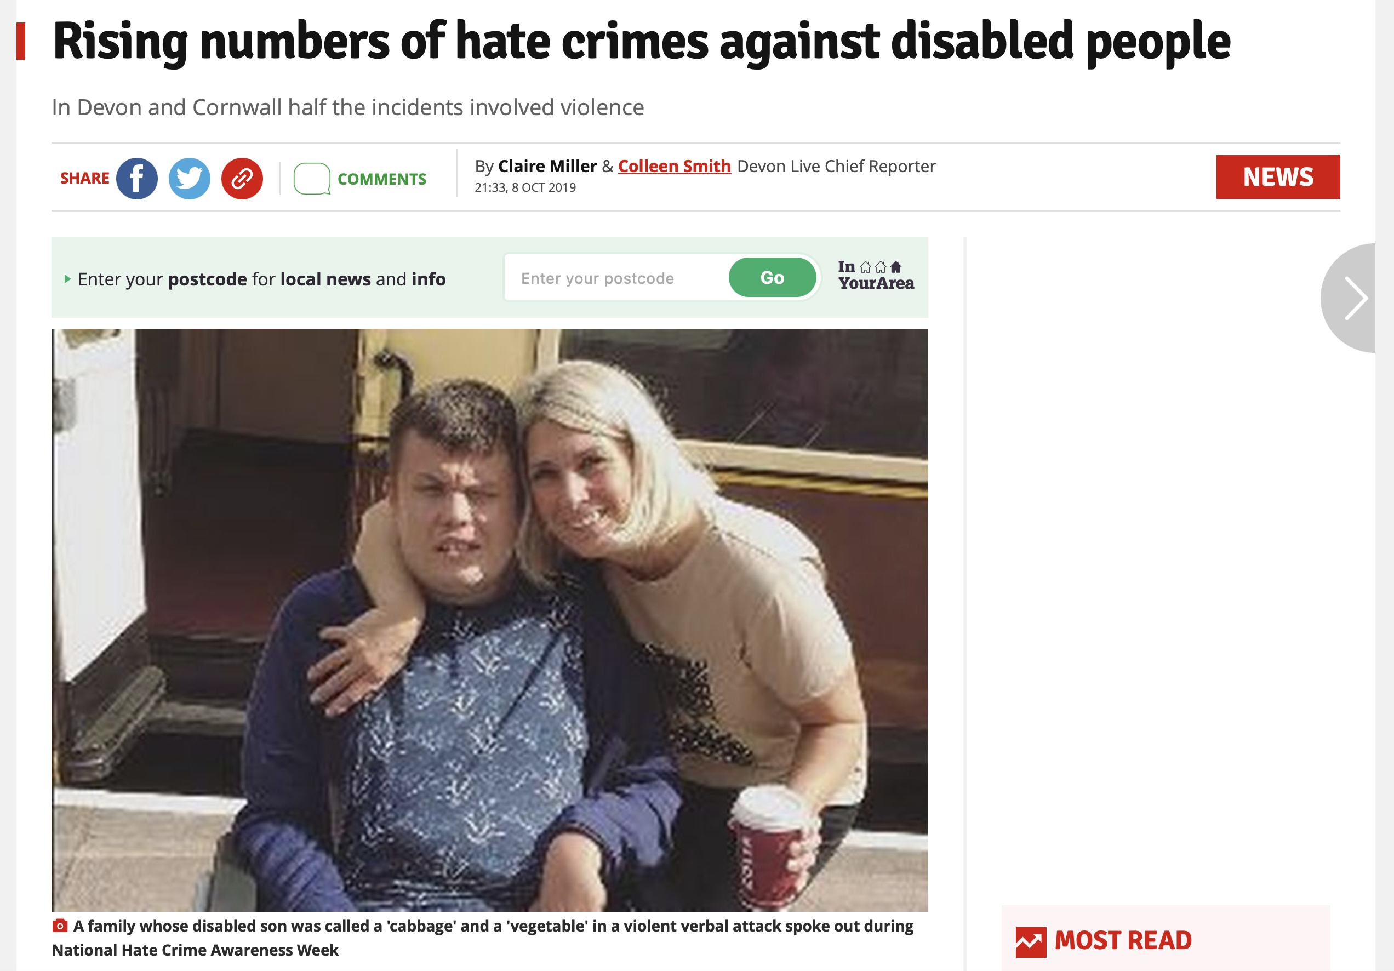
08/10/19

Slide 8
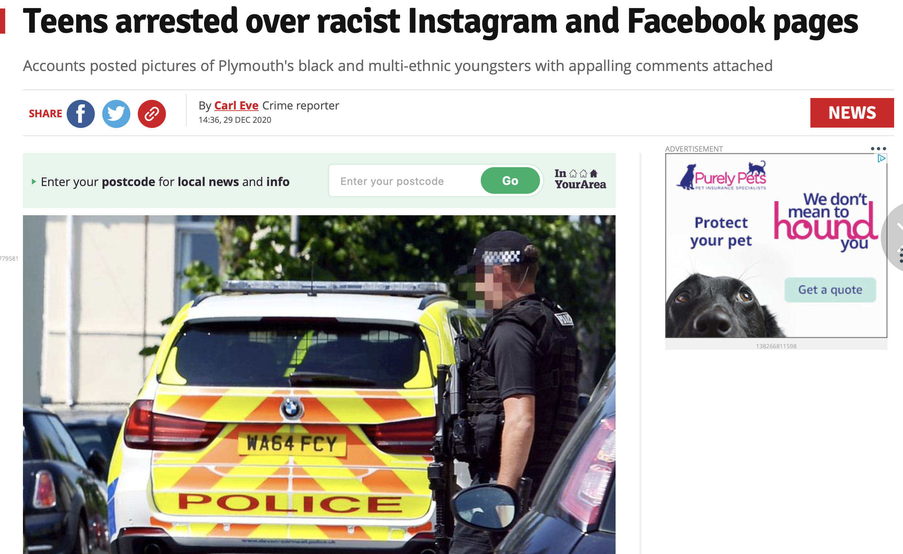
29/10/19

Slide 9
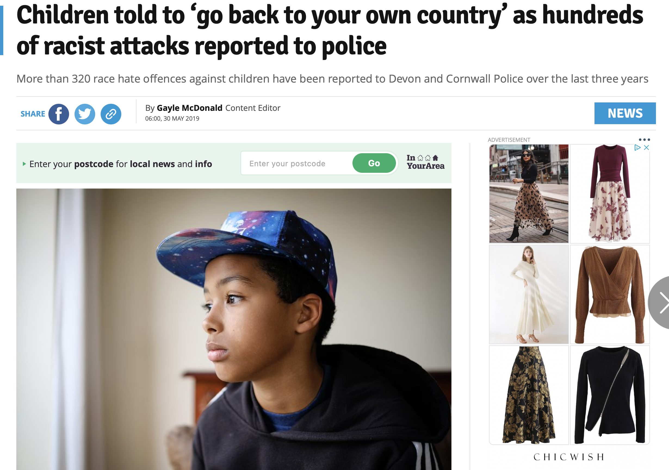
30/05/19

Slide 10
HOW ARE THESE INCIDENTS SIMILAR?
Notes:
You think you know what a Hate Crime is.
You think you can tell me an example of a Hate Crime.
You think you’ve witnessed a Hate Crime.

Slide 11
They are all examples of hate crimes
The offenders were all teenagers
The victims all had protected characteristics.
Devon and Cornwall Police investigated each hate crime.

Slide 12
WHAT IS THE AGE OF CRIMINAL RESPONSIBILITY?
Notes:
You think you know what a Hate Crime is.
You think you can tell me an example of a Hate Crime.
You think you’ve witnessed a Hate Crime.

Slide 13
THE AGE OF CRIMINAL RESPONSIBILITY IN ENGLAND AND WALES IS 10 YEARS OLD. A CHILD AGED BETWEEN 10 AND 17 CAN BE ARRESTED AND TAKEN TO COURT IF THEY COMMIT A CRIME.
10-17 year olds are treated differently from adults and are:
dealt with by youth courts
given different sentences
sent to special secure centres for young people, not adult prisons.

Slide 14
HOW DO YOU SPEAK TO YOUR FRIENDS WHEN YOU’RE NOT IN SCHOOL?

Slide 15
Some young people are using social media apps to commit online Cyber Hate Crimes which is a criminal offence.
Writing a nasty comment about the way a person looks
Posting or sharing a picture of a person without their permission and writing a nasty caption
Making a group chat about a person and writing nasty things about them
Sending a person a private message that says horrible things about them because they are different
Posting emojis that are mean and nasty

Slide 16
WHY DO PEOPLE SAY CRUEL THINGS ON SOCIAL MEDIA?

Slide 17
TO LOOK GOOD IN FRONT OF THEIR FRIENDS
BECAUSE THEY’RE ANGRY
REVENGE/JEALOUSY
ASHAMED OR GUILTY
IT’S NOT AS BAD AS SAYING IT TO SOMEONE’S FACE
BECAUSE THEY THINK THEY CAN GET AWAY WITH IT

Slide 18
HOW WOULD YOU FEEL IF CRUEL COMMENTS WERE MADE ONLINE BECAUSE OF WHO YOU ARE?
Notes:
Upset
Angry
Depressed
Lonely
Scared
Afraid
Anxiety
Low self-esteem

Slide 19
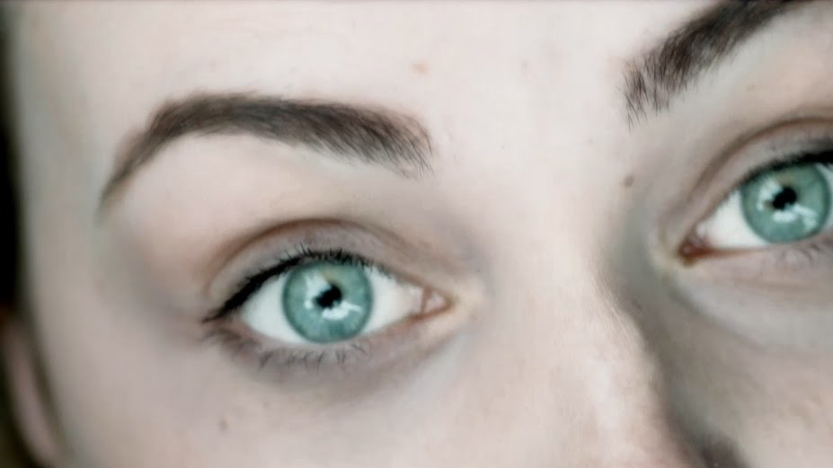
CYBER CRIME: CONSEQUENCES
You may have to go to court
Your details will remain on police systems
If found guilty, you
will have a
criminal recorD
It may result in a fine or a prison sentence
It will impact your ability to travel or to get/ keep a job
Notes:
Many employers won’t give you a job if you have a criminal record
Countries like Australia, Canada and America won’t let you into the country if you have a criminal record.
You could receive a prison sentence.
If you have a job and get found guilty of any Hate Crime your employer may fire you and you could lose your job.
You may have to pay a fine and pay compensation to the victim.

Slide 20
BEFORE YOU SAY SOMETHING, ACT OR POST ANYTHING ON SOCIAL MEDIA OR SEND A MESSAGE REMEMBER TO THINK:
IS IT TRUE?
IS IT HELPFUL?
IS IT INSPIRING?
IS IT NECESSARY
IS IT KIND?

Slide 21
REPORTING HATE CRIME
Online reporting tools
Trusted adult
Notes:
Report it to the Police via 999, 101, or online, Stop Hate UK (You can do anonymously if you don’t want to share your personal details)
Tell an adult such as the person you live with, a member of teaching staff or a youth worker.
If you are in a group chat and someone is making racist comments about another person in the chat, tell the person making the racist comments to stop. Also, privately message the victim to see if they’re ok.

Slide 22
SUPPORT
0800 1111
victimsupport.org.uk
report-it.org.uk
Notes:
Get safe online – cybersecurity
Childline – website and confidential counselling by phone, email or online chat
True vision – Information and guidance about hate incidents including reporting routes
ThinkUKnow – information about broad range of online safety issues for young people
CEOP reporting button – click to be taken to the CEOP reporting tool to report grooming issues

Slide 23
Questions?

