Slide 1
Hello!
My name is XXXXXX

Slide 2
Our online friends

Slide 3
Notes:
Ask questions to engage and find out what devices the children use at home
Children of this age may not understand what the internet or online is but they will recognise the devices

Slide 4
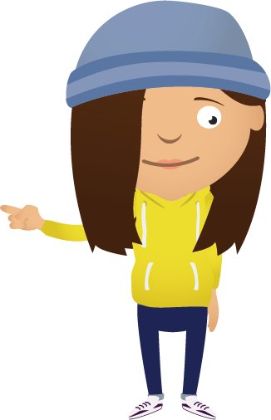
Notes:
Ask what games/apps/websites are they using – you may need to look at YouTube in more detail
Minecraft
YouTube
Google
Clash Royale
Slither.io
Cbeebies
Roblox

Slide 5
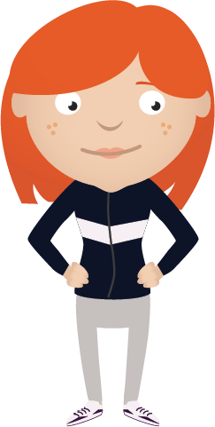
What is personal information?
Notes:
Ask what is our personal information
Usually you will get Name, age, address, school, boy or girl
Plus passwords/email/phone numbers etc
Explain that we should only share personal information with people we trust

Slide 6
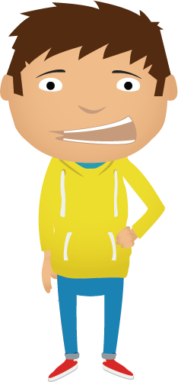
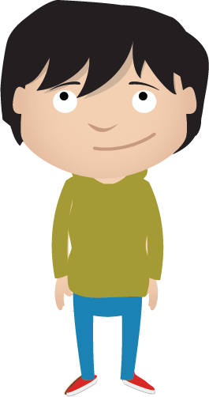
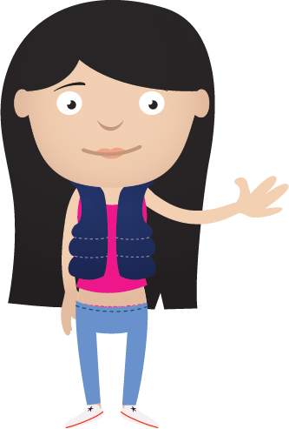
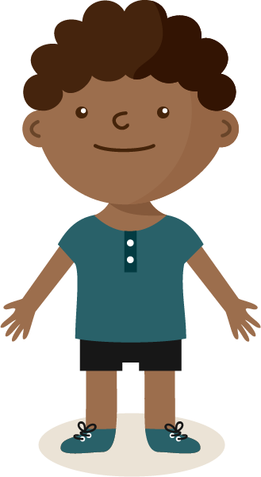
Our friends
Notes:
Know them, trust them, they are kind to us
Ask about playing games with friends
What do we call a person we don’t know – STRANGER
Talk about playing games or chatting online
It is safest to play games with people who are already friends – not Strangers

Slide 8
?
Notes:
People you don’t know are strangers. They’re not always who they say they are
Be nice to people on the computer like you would in the playground
Keep your personal information safe
If you ever get that ‘uh oh’ feeling, you should tell a grown up you trust

Slide 9
What have we learned today?

