Slide 1
Hello!
My name is XXXXXX

Slide 2
Halloween

Slide 3

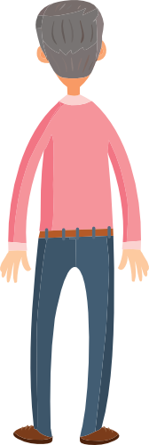

Slide 4
How do you think the person who has opened the door is feeling?
How do you think the young people at the door will be feeling?
What will they all be expecting?

Slide 5
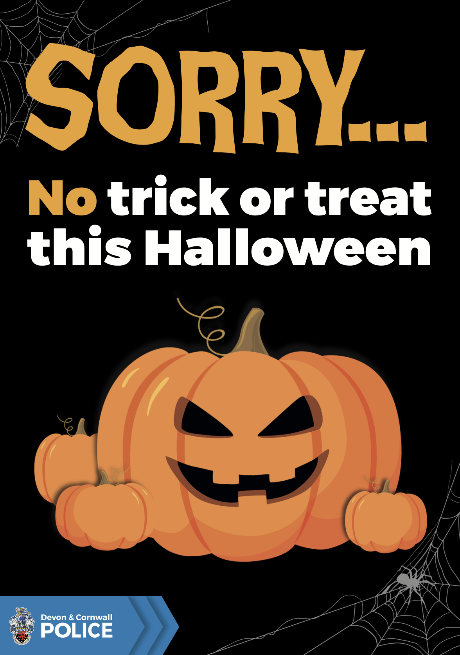
What should you do if you see this sign?

Slide 6
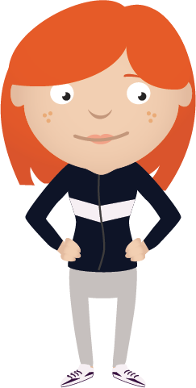
How would you feel?
Someone has to clean it up and that person could be you...

Slide 7
What could happen if someone throws eggs at windows or passing cars?
Notes:
If a person is killed by someone throwing stones at a vehicle they may be charged with manslaughter, without intent.

Slide 8
Anti social behaviour is…
Any behaviour that causes harassment, alarm or distress to any person not of the same household

Slide 9
Can you think of any other Halloween
anti social behaviour?

Slide 10
Tips for staying safe at Halloween
Plan your evening
Make sure your parents/guardians know where you are
Stay with your friends, do not go out on your own
Make sure your phone is charged and has credit
Make sure you have a safe way of getting home

Slide 11
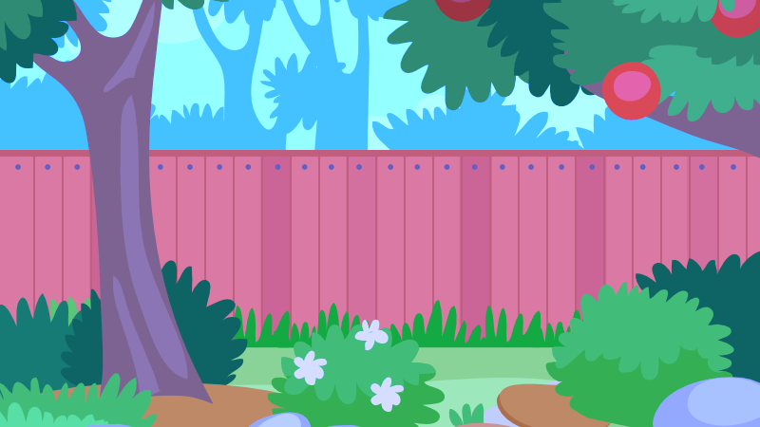



Bonfire night
Notes:
What is going on in the picture?
What is the one obvious problem ?
What are the risks?
Distance from firework etc no adults presents
What are the choices?

Slide 12
Remember who might be affected...
Have fun, but remember to be responsible, safe and respectful.

Slide 13
What have we learnt today?

Slide 14
Thank you.

