Slide 1
Hello!
My name is XXXXXX

Slide 2
Anti-social behaviour

Slide 3
Can anyone tell me what is anti social behaviour?

Slide 4
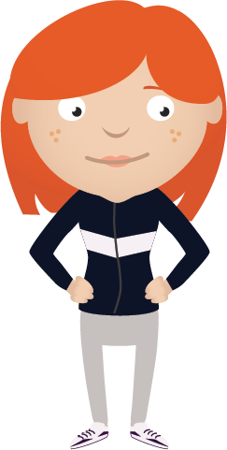
Anti social behaviour is…
Any behaviour that causes harassment, alarm or distress to any person not of the same household

Slide 5
Can you think of any anti social behaviour?

Slide 6
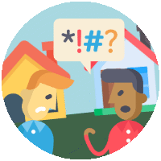
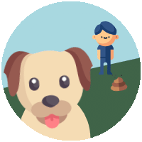
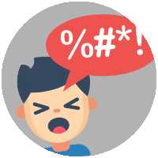
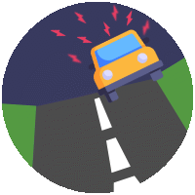
Damage
Graffiti
Litter
Fireworks
Neighbours
Dogs
Noise
Cars

Slide 7
What could happen if someone throws eggs at windows or passing cars?
Notes:
If a person is killed by someone throwing stones at a vehicle they may be charged with manslaughter, without intent.

Slide 8
What are hoax calls?
Notes:
Prank or ‘hoax’ calls to the emergency services are not only against the law, they cost lives, as they reduce response times of vehicles and staff getting to real emergencies.
Calls are traced and recorded so that callers can be identified.
Mobile phone companies can disconnect phones if they have been used to make hoax calls.
The maximum penalty is £5,000 and six months in prison.
Emergency vehicles have been involved in road crashes when responding to hoax calls.

Slide 9
What can the police do about anti social behaviour?

Slide 10
Take your name
Take you home
Letter sent home
Notes:
Officers will take your name and address
Officers can take you home or to a place of safety
Letter sent home
If you continue to behave in an anti-social manner you may be put forward for an Acceptable Behaviour Contract (ABC)

Slide 11
Let’s talk about weapons

Slide 12
What is a weapon?
Notes:
Students suggest weapon types. Anything can be a weapon

Slide 14
Who knows someone who has a BB Gun?
Notes:
Students suggest weapon types. Anything can be a weapon

Slide 15
Let’s play…
real or fake
Notes:
Prank or ‘hoax’ calls to the emergency services are not only against the law, they cost lives, as they reduce response times of vehicles and staff getting to real emergencies.
Calls are traced and recorded so that callers can be identified.
Mobile phone companies can disconnect phones if they have been used to make hoax calls.
The maximum penalty is £5,000 and six months in prison.
Emergency vehicles have been involved in road crashes when responding to hoax calls.

Slide 16
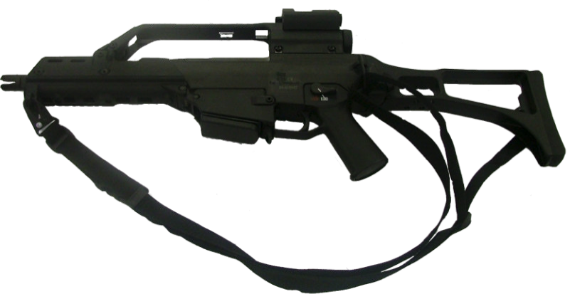
Fake
Notes:
If a person is killed by someone throwing stones at a vehicle they may be charged with manslaughter, without intent.

Slide 17
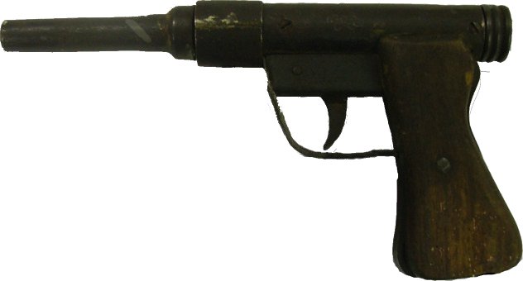
Real
Notes:
If a person is killed by someone throwing stones at a vehicle they may be charged with manslaughter, without intent.

Slide 18
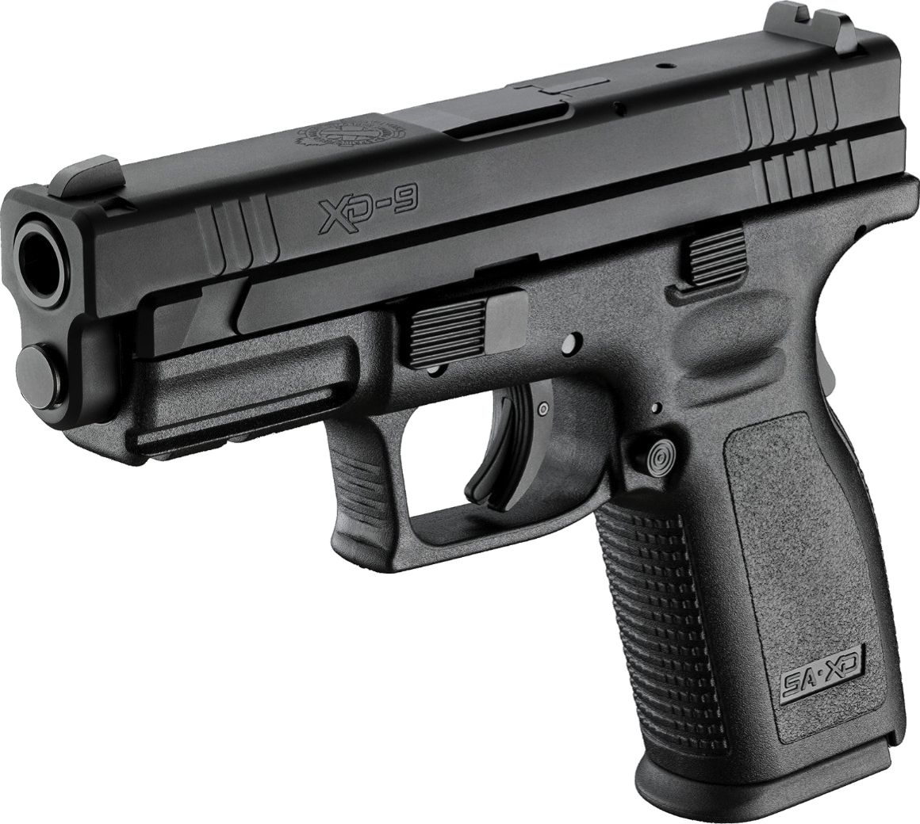
Real
Notes:
If a person is killed by someone throwing stones at a vehicle they may be charged with manslaughter, without intent.

Slide 19
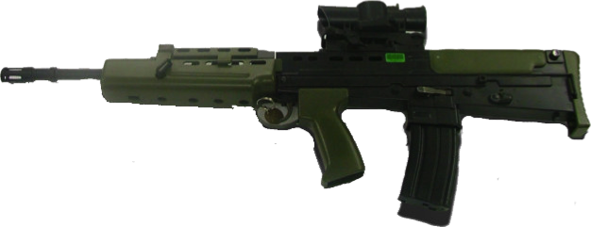
Fake
Notes:
If a person is killed by someone throwing stones at a vehicle they may be charged with manslaughter, without intent.

Slide 20
Real
Notes:
If a person is killed by someone throwing stones at a vehicle they may be charged with manslaughter, without intent.

Slide 21
It’s hard to tell isn’t it!

Slide 22
Are you allowed to carry a weapon in public to protect yourself?
Notes:
Section 19: it is an offence for a person to have with them in a public place without lawful authority or reasonable excuse a loaded shot gun, an air weapon (whether loaded or not), any other firearm (whether loaded or not) together with ammunition suitable for use in that firearm, or an imitation firearm.
If you were carrying a BB gun, would the people or the police be able to tell it wasn’t a real gun. People would think that you are breaking the law.
Don’t mention knives…. yet

Slide 23
Let’s talk about knives
Notes:
Prank or ‘hoax’ calls to the emergency services are not only against the law, they cost lives, as they reduce response times of vehicles and staff getting to real emergencies.
Calls are traced and recorded so that callers can be identified.
Mobile phone companies can disconnect phones if they have been used to make hoax calls.
The maximum penalty is £5,000 and six months in prison.
Emergency vehicles have been involved in road crashes when responding to hoax calls.

Slide 24
Is someone safer if they carry a knife?
Notes:
No
Some young people think if you carry a knife then it will provide protection. But statistics show that if you carry a knife or weapon then you are more likely to end up being hurt. You can be seen as threatening. You might also end up being hurt by your own weapon. It is also illegal to carry knives and other weapons. Met website

Slide 25
Arrest
Details taken

Slide 27
Remember, we all have the right to feel safe all of the time and we can talk with someone about anything.

Slide 28
Help
Teachers
Fearless
Family
Trusted adult

Slide 29
What have we learned today?

