Slide 1
Hello!
My name is XXXXXX

Slide 2
Anti-social behaviour

Slide 3
Can anyone tell me what is anti social behaviour?

Slide 4
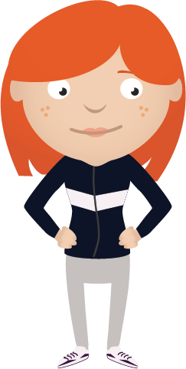
Anti social behaviour is…
Any behaviour that causes harassment, alarm or distress to any person not of the same household

Slide 5
Can you think of any anti social behaviour?

Slide 6
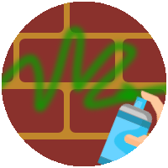
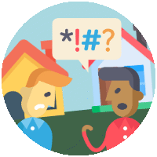
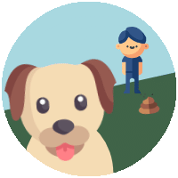
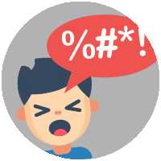
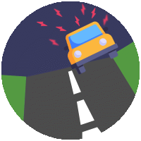
Damage
Graffiti
Litter
Fireworks
Neighbours
Dogs
Noise
Cars

Slide 7
What could happen if someone throws eggs at windows or passing cars?
Notes:
If a person is killed by someone throwing stones at a vehicle they may be charged with manslaughter, without intent.

Slide 8
What are hoax calls?
Notes:
Prank or ‘hoax’ calls to the emergency services are not only against the law, they cost lives, as they reduce response times of vehicles and staff getting to real emergencies.
Calls are traced and recorded so that callers can be identified.
Mobile phone companies can disconnect phones if they have been used to make hoax calls.
The maximum penalty is £5,000 and six months in prison.
Emergency vehicles have been involved in road crashes when responding to hoax calls.

Slide 9
What can the police do about anti social behaviour?

Slide 10
Take your name
Take you home
Letter sent home
Notes:
Officers will take your name and address
Officers can take you home or to a place of safety
Letter sent home
If you continue to behave in an anti-social manner you may be put forward for an Acceptable Behaviour Contract (ABC)

Slide 11
Remember, we all have the right to feel safe all of the time and we can talk with someone about anything.

Slide 12
Help
Teachers
Fearless
Family
Trusted adult

Slide 13
What have we learned today?

