Slide 1
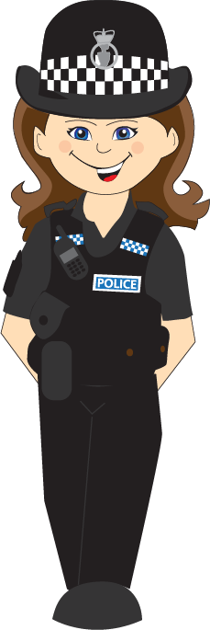
Road Safety

Slide 2
What is road safety about?

Slide 3
Staying safe when walking, cycling or in a car
Keeping yourself safe and your friends and family too
Making smart choices
Making sure you don’t get hurt or even killed

Slide 4
How can you stay safe on or near a road?

Slide 5
Use paths
Use Safe to cross places
Look
Listen
Step out before looking
Stand on road
Play on road
Be aware of racing cars

Slide 6
You are going to cross the road.
Where should you look to cross?

Slide 7
It is dark and you are outside next to a road. What may you wear to help you stay safe?

Slide 8
Did you know…
At night, a driver can usually see you from about 30 metres away.
If you wear high-vis gear, they can see you from 160 metres away, more than five times further!

Slide 9
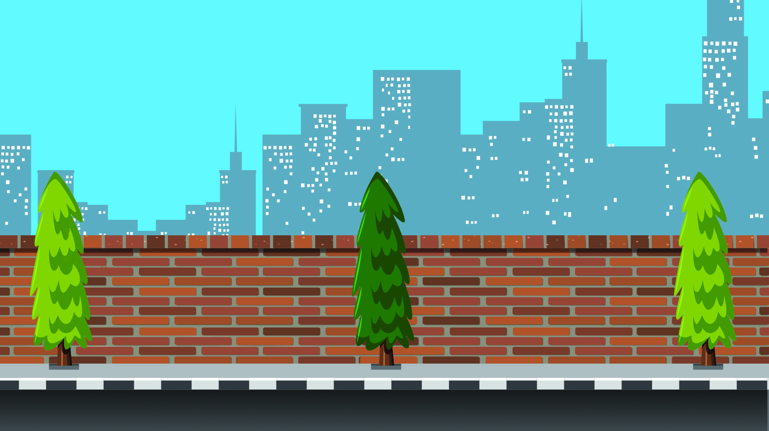
If aliens visited Earth, how would you tell them to keep safe crossing the road?

Slide 10
Stop
Look
Listen
Think
Cross

Slide 11
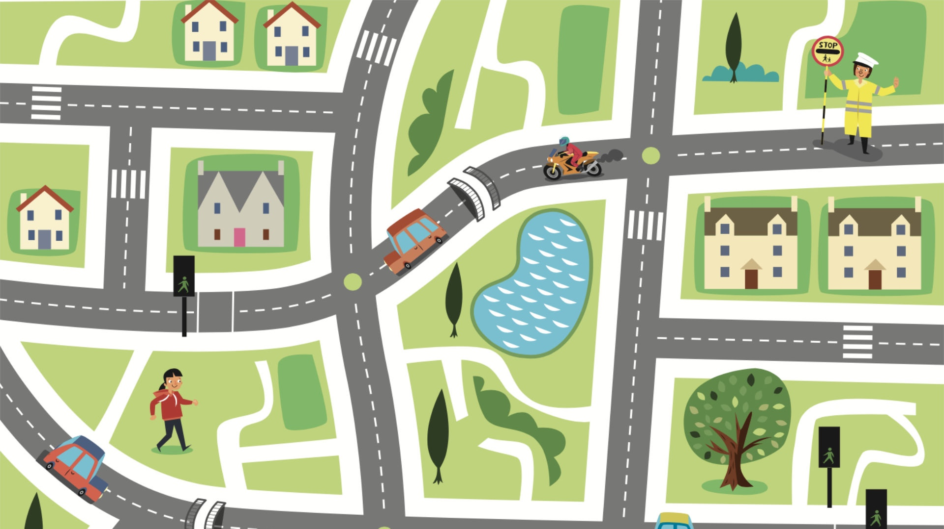
Find the safest route to the park
Activity 1

Slide 12
Can you spot a hazard?

Slide 17
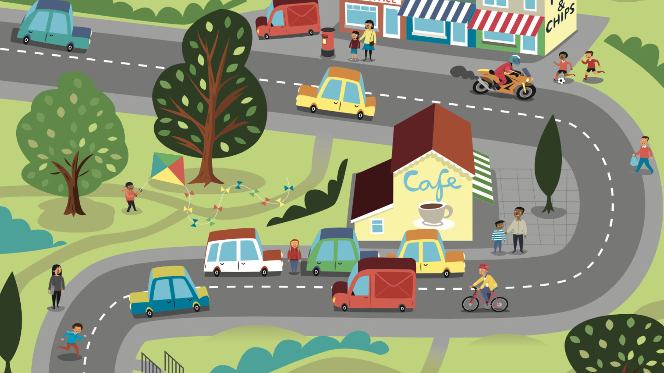
Work book
Spot the hazard
Activity 2

Slide 18
Did you know…
512
children aged seven or younger were killed or seriously injured on British roads in 2021.
Children aged between 11 and 14 are more likely to get hurt or killed while walking or cycling than any younger children.
Why do you think this is the case?

Slide 19
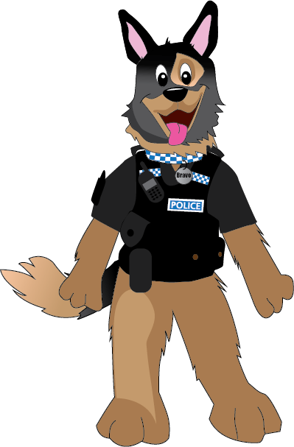
It is important that you wear your seatbelt while you are in the car. There are steps to follow when you are in the car while you are wearing your seatbelts they are:
Belt up before the car sets off
Belt up for every journey
Check everyone in the car belts up too.
Never undo your seatbelt during a journey
You must use a booster seat if you’re under a certain height.
Belt up!
Notes:
Did you know: If you’re not wearing your seatbelt and you’re in a crash, you would be thrown forward with the force of a small elephant

Slide 20
What equipment can we use to keep ourselves safe?

Slide 21
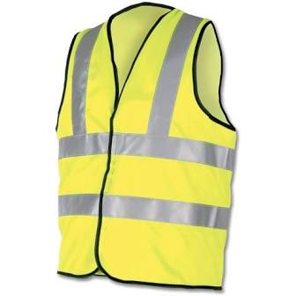

Slide 22
What have we learned today?

