Slide 1
Anti-social
behaviour

Slide 2
What is anti social behaviour?
Activity 1

Slide 3
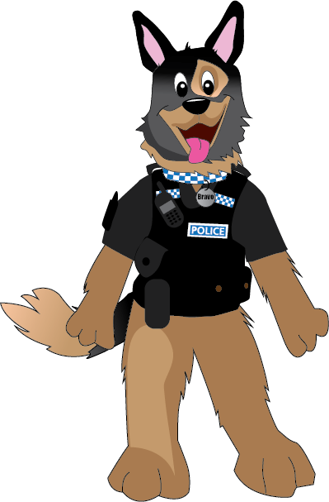
Anti social behaviour is…
any behaviour that causes harassment, alarm or distress to any person not of the same household

Slide 4
Can you think of any types of anti-social behaviour?

Slide 5
Damage
Graffiti
Noise
Fireworks
Littering
Neighbours
Large groups
Throwing objects
Drunks
Dogs

Slide 6
Can you match the words to the pictures?
Activity 2

Slide 7
What is in the bag?
Activity 3

Slide 8
Who are the victims of anti-social behaviour?

Slide 9
Elderly
Businesses
Children
Our homes
School
Community
Disabled
All of us

Slide 10
What sort of people do anti-social behaviour?

Slide 11
Young people
Drunks
Criminals
Drug users
You
Adults

Slide 12
How would you feel if you were a victim of
anti-social behaviour?

Slide 13
What are the consequences for the offender?

Slide 14
10
ASB Warning
ABC contract
Prison
Youth Offending team

Slide 15
You can report ASB to the police or local authority.

Slide 16
What have we learned today?

Slide 17
Worksheet
Activity 4-5

